Slide 1
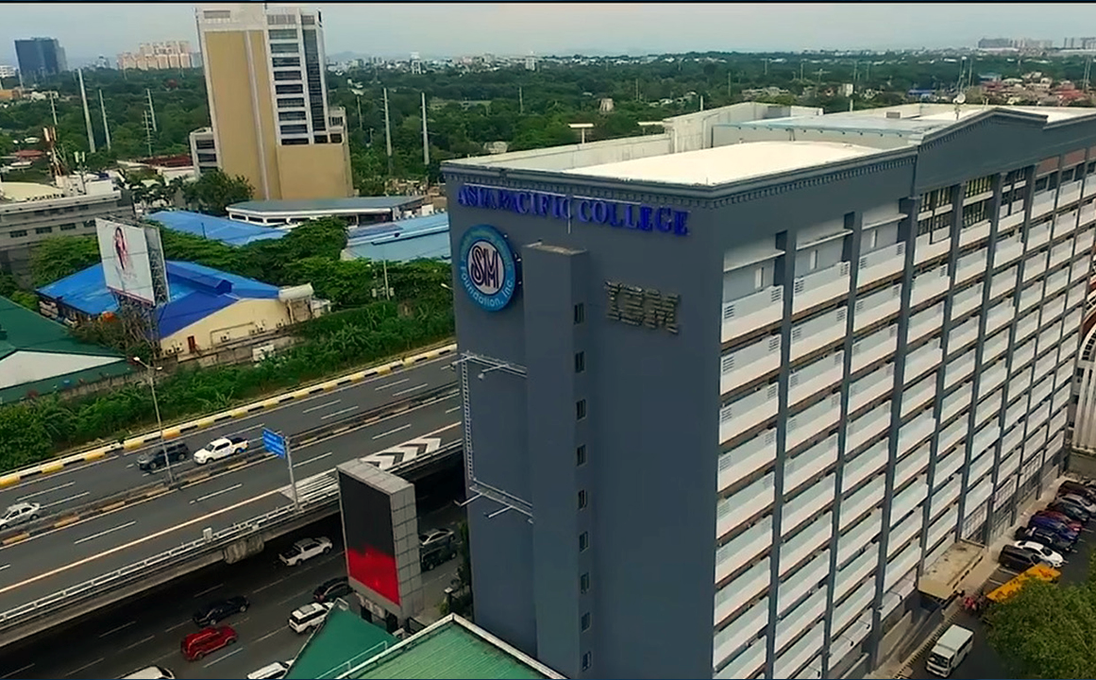

Project management plan
(REVISED)

Slide 2

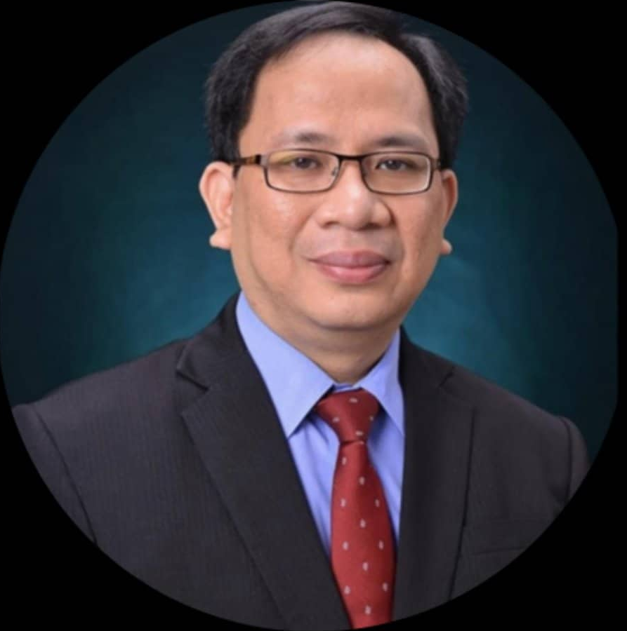


Introduction
Registered Name | Asia Pacific College – Information Technology and Resource Office
Company Logo (Tentative)
Address | 5th Floor, Asia Pacific College, 3 Humabon Place, Barangay Magallanes, Makati City, Metro Manila 1232
Line of Business | Information Technology Assistance
Type of Customers | School Faculty and Students
Date of Registration | 1994
President | Jose F. Castillo
Number of Employees | 10
Presented by: Allan Nefalar

Slide 3
Problem statement
The Asia Pacific College ITRO Department lacks a dedicated ticketing system to help them address the school’s technical-related problems instead of using an email-based reporting system.
Presented by: Allan Nefalar

Slide 4
Project deliverables and milestones
RAMS Corner Ticketing System is a web-based application that would make use of a ticketing method like that of Discord and other outsourcing companies that would not only help the students and teachers get an equal chance to be given audience by the ITRO. Making troubleshooting easier and much more convenient.
Presented by: Kieyl Ponce

Slide 5
Project deliverables and milestones
A single system for accessing all queries and reports, rather than needing to navigate two separate ITRO email accounts
a Knowledge Base feature for the solutions to the most common problems that can be addressed by the client themselves, thus, reducing the tickets received by the ITRO by at least 30 – 40%.
Presented by: Kieyl Ponce

Slide 6
Project deliverables and milestones
Streamlined and tailor-made ticketing service system for the ITRO workflow.
Added features to automatically send a uniform and accurate ticket by three (3) to five (5) mouse clicks and drastically lower the time it takes for the client to send a query from five to ten minutes, down to 10-90 seconds.
Presented by: Kieyl Ponce

Slide 7
Project deliverables and milestones
User manual, system requirement specification, and other necessary documentations will be provided to the ITRO to effectively use the new system.
A report detailing the benefits and cost savings achieved through the implementation of the RAMS Corner: Ticketing Service System
Presented by: Kieyl Ponce

Slide 8
Project deliverables and milestones
Summary Milestone Schedule
Project Milestone | Target Date (MM/DD/YYYY)
Project Idea | 03/24/2022
Project Proposal Approval | 05/12/2022
Project Management Plan Approval and Sponsor Acceptance | 07/11/2022
System Design Approval | 11/14/2022
Low/High-Fidelity Wireframe Approval | 12/13/2023
Verified Use Case Requirements | 07/25/2023
Successful Testing for Release 1 | 07/31/2023
Successful Testing for Release 2 | 08/03/2023
Successful Testing for Release 3 | 08/07/2023
Successful Integration Testing | 08/11/2023
Successful User Acceptance Testing | 08/15/2023
Successful Performance Testing | 08/17/2023
Successful Production Readiness Testing | 08/22/2023
Successful Parallel Testing | 08/24/2023
Discovery and Feedback | 09/13/2023
Presented by: Bryan Geneta

Slide 9
Stakeholder Analysis
Presented by: Bryan Geneta

Slide 10
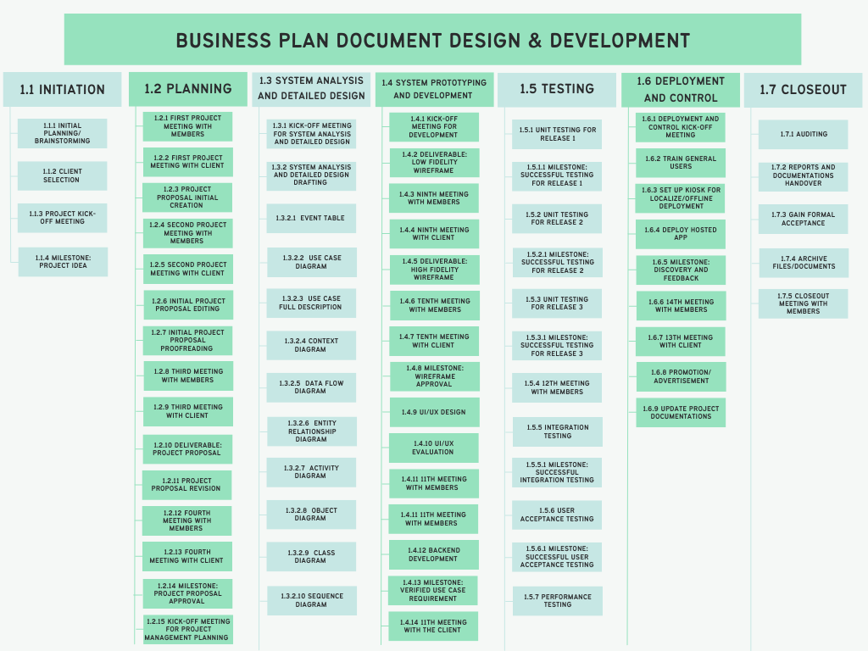
WBS
RAMS CORNER: ITRO TICKETING SERVICE SYSTEM
Presented by: Ruth Morallos

Slide 11
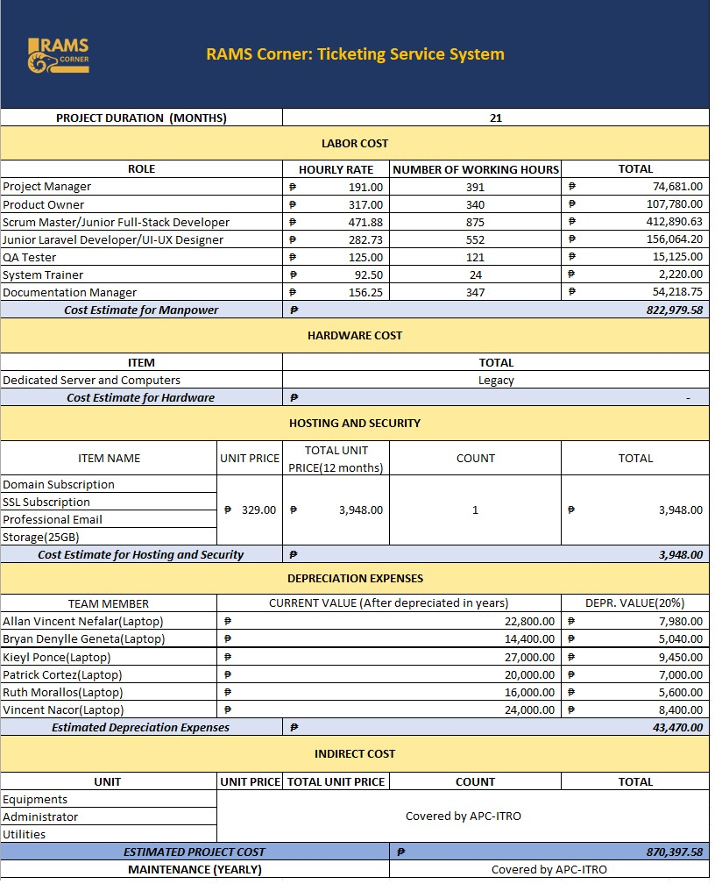
ESTIMATED PROJECT COST
Reference from: https://www.glassdoor.com/Salaries
Presented by: Allan Nefalar
Notes:
https://ph.indeed.com/?r=us

Slide 12
change control board
Name | Position | CCB Role
Mr. Jose F. Castillo | ITRO Head | Project Beneficiary
Kieyl Ponce | UI/UX Designer | Product Owner
Presented by: Patrick Cortez

Slide 13
STAFFING MANAGEMENT
Role | Authority | Responsibility | Competency
Project Sponsor | One that provides the ideas and asks for help for the project team to fulfill. the one who also approves the project’s business case and budget. able to assign project resources and give high-impact approval for modifications to the project's scope, timeline, and budget. | Ensures the team produces good results. Gives insights and advice to the team and project manager. Assists in updating the company on the status and advantages of the project. | Strong capacity for strategic thought and leadership communication. Profound comprehension of the organization's mission, objectives, and values. Possibility of providing the initiative with resources and support.
Project Manager | Handles the team and makes the decisions, can distribute project resources, and provide the go-ahead for low-impact adjustments to the project's scope, timetable, and budget. | Has the authority and the ability to oversee all the aspects of the project including its, planning, implementation, monitoring, and release. | Solid understanding of the project, leadership skills, communicating skills, and project management skills, risk management skills, team management and can learn continuously and develop their knowledge.
Internal Users of the system (Developers) | Has access to the system and the power to improve and decode errors when necessary. | In charge of coding the software and UI/UX of the project and handles the system. | Has the technical expertise, background, talents, and experience necessary to build software solutions successfully.
External users of the system (Documentation) | Handles the paper and documents the process of the project from start to end. | In charge of the documentations and the deliverables of the project. | The ability to efficiently develop and manage project documentation is possessed by a documentation specialist, who possesses a range of abilities, expertise, traits, and skills.
Presented by: Patrick Cortez

Slide 14
QUALITY ASSURANCE
Defining Quality Standards
Agile Quality Auditing
Quality Metrics :
Agile Metrics such as Velocity, Burn-Down Charts, and Sprint Reviews
o Defect Density: The number of defects found per unit of measure
o Defect Severity: The classification of defects based on their impact on the system.
Test Coverage: The percentage of the system that has been tested
Test Case Pass Rate: The percentage of test cases that have been passed
Root Cause Analysis Effectiveness: The percentage of issues that have been resolved at the root cause level.
Continuous Improvement
Compliance with Industry Standards
Reviewing Customer Feedback
Presented by: Kieyl Ponce

Slide 15
ROLES & RESPONSIBILITIES
ROLES | RESPONSIBILITIES
Project Manager | Task Delegation Ensures that project deliverables are done on time Facilitates team meetings with the project client and development team for possible changes Executes scope change requests from project client and development team if changes will be necessary as discussed
Product Owner | Defines and prioritizes the project requirements and ensures that the final product meets the needs of the stakeholders. Works closely with the Project Manager and Scrum Team to ensure that the project deliverables align with the scope. Represents the stakeholders and clients’ best interest during meetings.
Scrum Master | Facilitates the Agile Development process with regards to the Scrum framework Works closely with the Project Manager and Product Owner to ensure that the project is progressing according to the defined scope.
Documentation Team | Oversees the project documentation deliverables and ensures that the documents are presentable and free from errors. Ensures that the project documents are adjusted and updated according to what the project client and project manager discussed on change requests.
QA Tester | Ensures that the system is free of bugs and is usable Oversees the development to assess the quality of the system prior to its deployment
Junior Developer | Responsible for testing the source code to identify and fix any issues or bugs. They collaborate with quality assurance (QA) engineers to ensure the software meets the desired functionality and quality standards.
Project Sponsor | As a key stakeholder, the client provides all the necessary information needed by the project team in their work organization, if necessary, in the project development Suggests changes in the system according to their work organization that should ensure the system is properly developed before deployment
Presented by: Patrick Cortez

Slide 16
Communication matrix
Channel | Sender | Recipient | Type | Frequency | Format Used | Delivery media
Project Planning | Project Manager | Stakeholders | Meeting | Prior to commencing the project | Formal | Email, MS Teams,
Release Planning | Project Manager, Project Team | Stakeholders | Meeting | Revisions will be made as needed before the initiation of the project. | Formal | Email, MS Teams,
Sprint Planning | Project Manager | Project Team | Meeting | Once a week | Informal | Email, MS Teams,
Management Processes | Project Manager, Project Team | Stakeholders | Artifact | The project will be reviewed and updated as necessary before it begins. | Document | Email, Google Spaces, Google Docs, Google Drive, Microsoft 365
Product Backlog | Project Manager | Project Team | Artifact | Once a week | Document | Google Docs, Google Spaces
Project Update | Project Manager | Project Team | Meeting | Once a week | Informal | Email, MS Teams, Google Meet
Presented by: Allan Vincent Nefalar

Slide 17
Risk register
Risk ID | Risk Description | Risk Category | Risk Owner | Probability | Impact | Risk Score | Status | Target Resolution Date
RID 001 | Security Breaches - personal information can be compromised when there is weak security for the system. | Vulnerability in Security | Developer Team | 3 | 5 | 15 | Closed | 12/2022-03/2023
RID 002 | System Downtime - inability to raise and resolve tickets in a timely manner | System Failure | Developer Team, Project Manager | 3 | 4 | 12 | Open | 03/2023-06/2023
RID 003 | Inadequate Scalability and Elasticity –unscalable or inelastic system will not be able to handle the increase or decrease in the volume of tickets received daily | System Failure | Project Manager | 3 | 5 | 15 | Open | 07/23-09/23
RID 004 | Lack of Integration –Inability to integrate means a decrease in productivity, that will therefore cause operational damage. | System Failure | Developer Team | 3 | 3 | 9 | Open | 06/23-08/23
Presented by: Ruth Morallos

Slide 18

Transition approach
ITSupport@apc.edu.ph
itro@apc.edu.ph
RAMS Corner:
Ticketing Service System
Presented by: Vincent Nacor

Slide 19
Transition approach
Communication Plan
Transition Planning
Knowledge Transfer
System Deployment
Presented by: Vincent Nacor

Slide 20

PROTOTYPE

Slide 21
Questions?

Slide 22
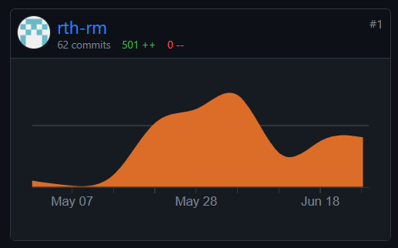
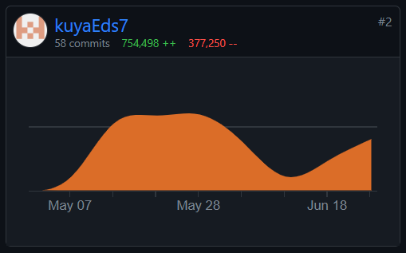
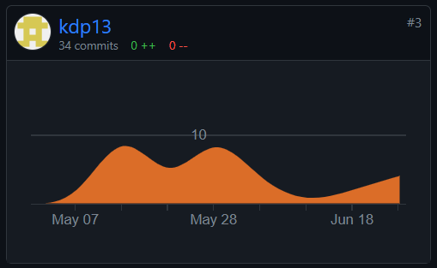
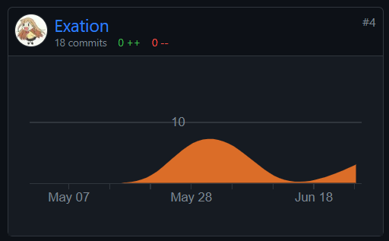
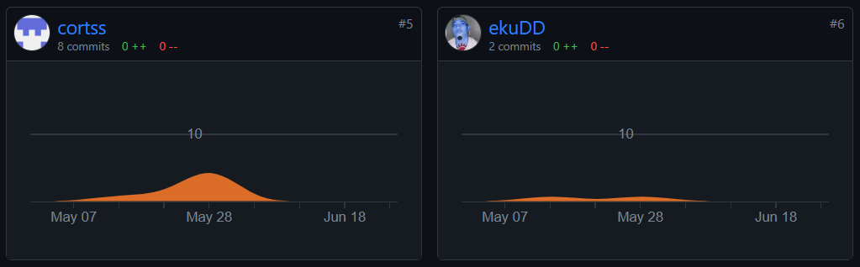
GITHUB COMMITS

Slide 23
Contribution/assignment
Name | Contribution/Assignment
Nefalar, Allan Vincent | Supervised the team and delegated tasks as the Project Manager Collaborated with the Scrum Master and Product Owner to ensure that the project is moving constantly while adhering to the stakeholders’ best interests. Contributed in OpenProject Gantt Chart Participated in Client Meetings Moderated some meetings with Project Adviser Added Company Profile, Project Charter, Stakeholder Management, Scope Management Plan, Cost Management Plan in WikiHub Maintained WikiHub and edited its general format for consistency. Created Stakeholder Analysis, Cost Management Plan, Communication Management Plan then created the initial Project Budget
Nacor, Vincent | Cooperated with the Project Manager as a part of the Documentation Team while adhering to the Documentation Manager’s guidelines Attended group and client meetings Created Schedule Management Plan Created Procurement Management Plan Added Schedule Management Plan and Procurement Management Plan in WikiHub

Slide 24
Contribution/assignment
Name | Contribution/Assignment
Ponce, Kieyl D. | Worked closely with Scrum Master and Project Manager as the Product Owner Contributed in OpenProject Gantt Chart Participated and moderated client and group meetings in the absence of the Project Manager Added Scope Management Plan, Business Case, and Quality Management Plan in WikiHub and revised budgeting plan for the project. Created Business Case, Scope Management, & Quality Management Plan Edited, revised and added missing contents for the Consolidated Project Management Plan. Edited and provided guidelines for the contents of the documents submitted by the Documentation Team as the Documentation Manager upon creation Created Group Presentation Deck
Geneta, Bryan | Cooperated with the Project Manager as a part of the Documentation Team while adhering to the Documentation Manager’s guidelines Attended group and client meetings Contributed in the creation of Work Packages.

Slide 25
Contribution/assignment
Name | Contribution/Assignment
Moralllos, Ruth | Spearheaded the team as the Scrum Master to make sure that the team adheres to the scrum methodology while overseeing the direction of the project and its development along with its documentation. Finalized the project’s budget and the WBS document Risk Management Plan Contributed on Stakeholder analysis Contributed on Business Case Plan then created the initial Project Budget Participated in project meetings Maintained WikiHub Added Company Profile, Project Charter Contributed in Cost and Benefit analysis Contributed in OpenProject Edited the consolidated project management paper Edited PowerPoint presentation for defense
Cortez, Patrick | Cooperated with the Project Manager as a part of the Documentation Team Attended group and client meetings Created Stakeholder’s Management, Implementation Plan, and contributed in the creation of Work Packages. Added Risk Management Plan Implementation and HR Management Plan in WikiHub

Slide 26
Thank you!

